Slide 1
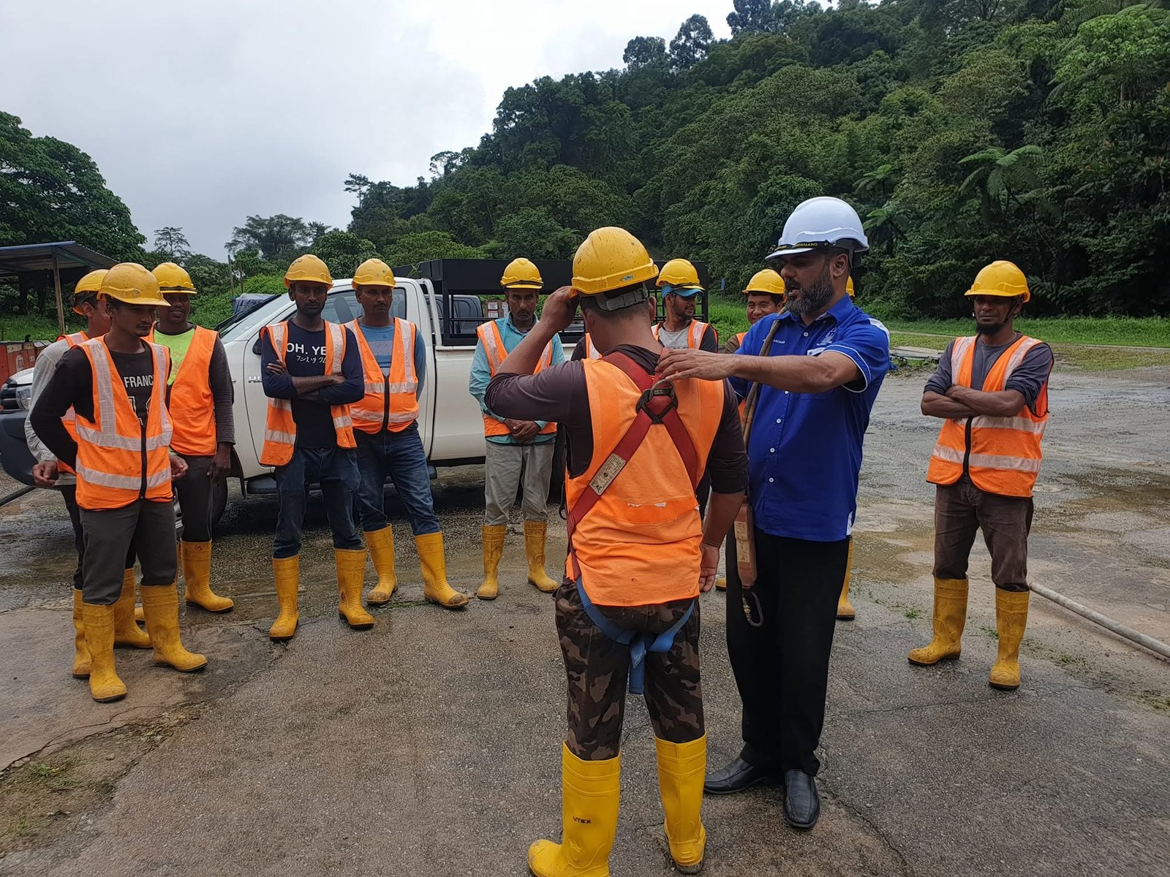
COMPANY PROFILE / CAPABILITY STATEMENT
NAJA SAFETY · JOHOR BAHRU · SEP 2026
NAJA
SAFETY
01
Occupational Safety & Health Training · Johor Bahru
COMPANY PROFILE & CAPABILITY STATEMENT — SEPTEMBER 2026
01 / 14

Slide 2
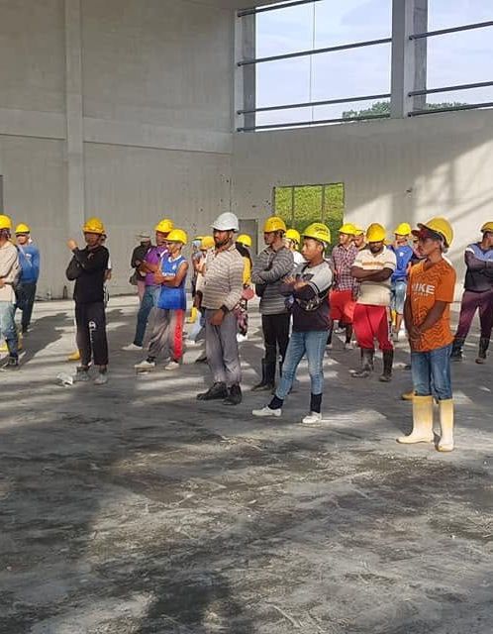
REGISTRATION
NAJA SAFETY
CAPABILITY STATEMENT
JOHOR BAHRU · SEP 2026
Company particulars
REGISTERED NAME | NAJA SAFETY | REGISTERED ADDRESS | 09-03, Blok C, Kompleks Austin Perdana, Taman Mount Austin, 81100 Johor Bahru, Johor
REGISTRATION NO. | 200603041203 (JM0449867-U) | CONTACT | James Issachar · 016-730 1802
REGISTERED UNDER | Registration of Businesses Act 1956 | EMAIL | najasafety@gmail.com [DECIDE: domain email]
CERTIFICATE | Borang D (Perakuan Pendaftaran) | SERVICE AREA | Nationwide — freelance trainer network, incl. Sabah & Sarawak
REGISTERED UNTIL | 14 July 2031 | BANK DETAILS | [INSERT: bank name, account name, account number]
STATUS | Sole proprietorship — branches: none | SST | [VERIFY: registered — yes/no + number]
YEAR ESTABLISHED | 2006 | INSURANCE | [PENDING: policy number and insurer]
PRINCIPAL | James Issachar A/L Daniel, Director & Lead Trainer | DOCUMENT | Company Profile & Capability Statement — Sep 2026
02
Bracketed [ ] items are pending confirmation before this document is circulated.
SOLE PROPRIETORSHIP
BORANG D
REG. 200603041203
EST. 2006
02 / 14
Full group in PPE at a client warehouse, 2020.

Slide 3
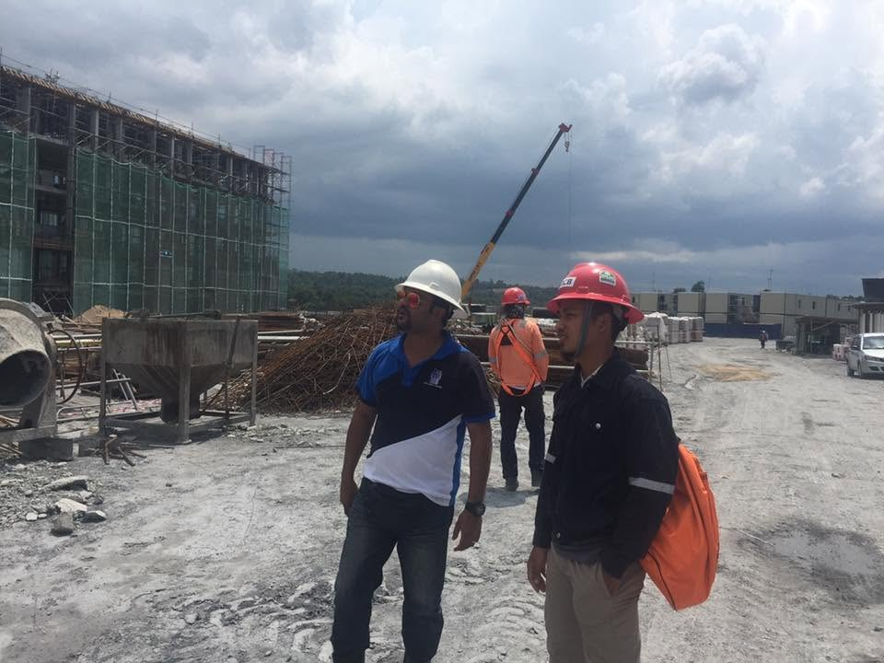
ABOUT
NAJA SAFETY
CAPABILITY STATEMENT
JOHOR BAHRU · SEP 2026
The practitioner behind the training
20+
years in the field — James Issachar has practised as an OSH consultant since May 2006
03
James Issachar A/L Daniel began at NIOSH as a vocational trainee. The two decades since have been spent on Malaysian manufacturing floors and construction sites.
Training and safety support are delivered through a freelance trainer network built over the same period.
He chairs Pertubuhan Kebajikan Shechinah Johor Bahru, a registered welfare charity founded in 2018.
OSH CONSULTANT SINCE 2006
BEGAN AT NIOSH
CHARITY · EST. 2018
03 / 14
James Issachar on a client construction site.

Slide 4
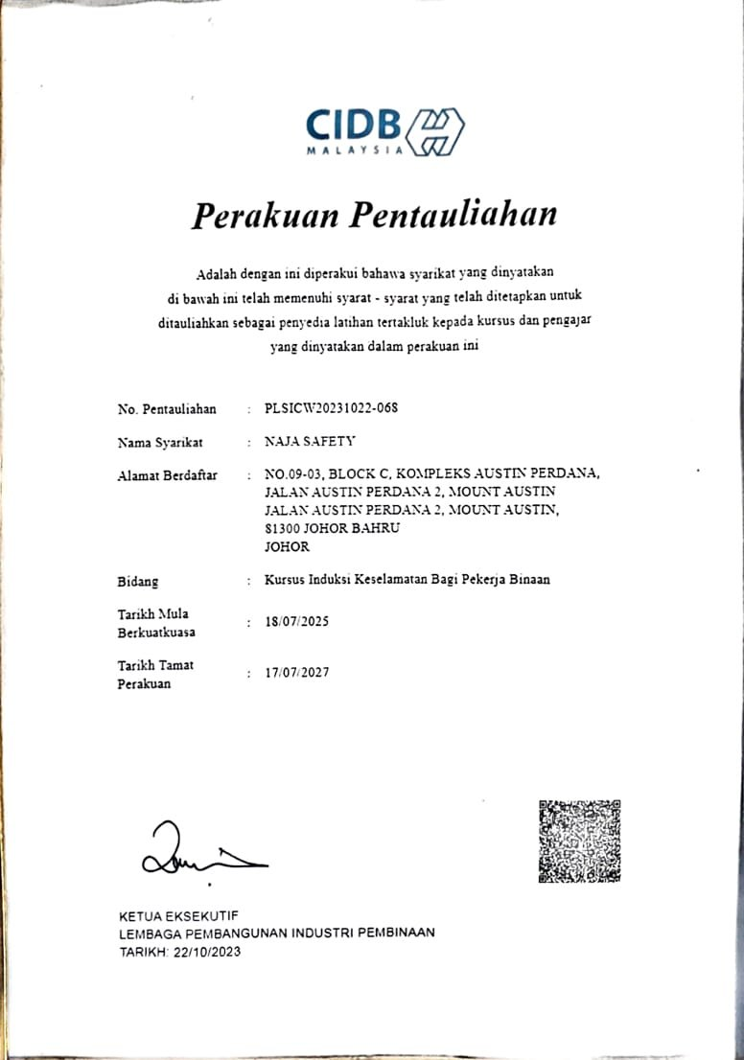
ACCREDITATION · 1 OF 2
NAJA SAFETY
CAPABILITY STATEMENT
JOHOR BAHRU · SEP 2026
Accredited for the CIDB safety induction
PERAKUAN PENTAULIAHAN · HOLDER: NAJA SAFETY
No. PLSICW20231022-068 · Valid 18 July 2025 – 17 July 2027
SCOPE
04
Kursus Induksi Keselamatan Bagi Pekerja Binaan — the Safety Induction Course for Construction Workers (SICW / "Green Card").
This course only. The accreditation does not extend to any other construction safety programme.
THE GREEN CARD
Workers who complete the induction are eligible for the CIDB Green Card. CIDB issues the card — Naja Safety does not.
Course context: cidbholdings.com.my — CIDB Green Card course (e-SICW).
PLSICW20231022-068
SICW · GREEN CARD
VALID TO 17 JUL 2027
04 / 14

Slide 5

ACCREDITATION · 2 OF 2
NAJA SAFETY
CAPABILITY STATEMENT
JOHOR BAHRU · SEP 2026
HRD Corp Accredited Trainer
HOLDER
James Issachar A/L Daniel — Trainer ID 62976. Valid 23 December 2025 – 23 December 2028.
STATUS
05
This is a personal trainer accreditation held by the principal. It is not a company-level training-provider registration.
WHAT IT MEANS FOR TRAINING
Training is delivered by an HRD Corp Accredited Trainer (ID 62976). Programmes are structured for HRD Corp claimability, subject to the employer's levy balance and grant approval.
[VERIFY: E-TRIS PROVIDER REGISTRATION — COMPANY LEVEL]
TRAINER ID 62976
VALID TO 23 DEC 2028
PERSONAL ACCREDITATION
05 / 14

Slide 6
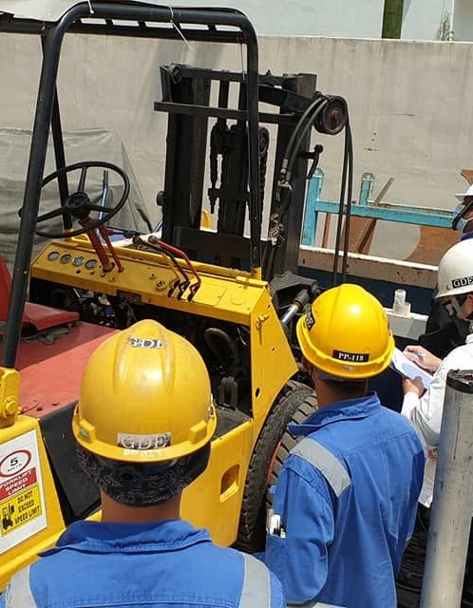
PROGRAMMES · 1 OF 3
NAJA SAFETY
CAPABILITY STATEMENT
JOHOR BAHRU · SEP 2026
Core compliance programmes
PROGRAMME | DURATION | NOTES
OSH Coordinator (Section 29A) preparation | 2–5 days | Prepares the employer's appointed employee [VERIFY: DOSH provider registration]
CIDB Green Card induction (SICW) | 1 day | Under PLSICW20231022-068 · priced per group-day
Safety induction & awareness | 1 day | —
HIRARC & risk management | 1 day | Output is a register the client keeps
Safety & Health Committee training | 2 days | Statutory driver: 40+ workers
Incident & accident investigation | 1 day | —
06
17 PROGRAMMES
ON-SITE DELIVERY
HRD CORP CLAIMABLE*
*subject to grant approval
06 / 14
Forklift safety briefing, 2021.

Slide 7
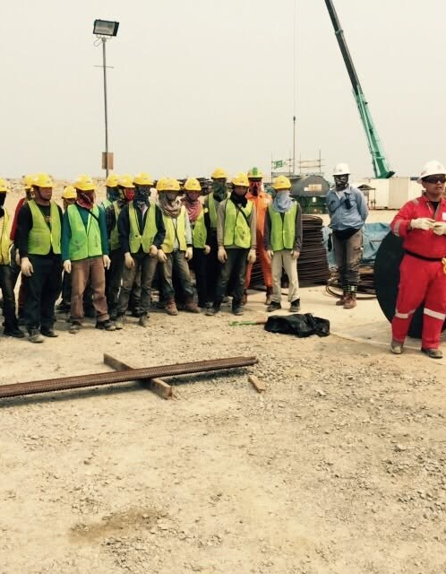
PROGRAMMES · 2 OF 3
NAJA SAFETY
CAPABILITY STATEMENT
JOHOR BAHRU · SEP 2026
Site and hazard programmes
PROGRAMME | DURATION | NOTES
Safety audit & inspection techniques | 2 days | —
Site safety management | 2 days | Supervisor / manager audience
Toolbox talk & safety briefing skills | Half day | —
Working at Height — awareness | 1–2 days | [CONFIRM: practical session included]
Scaffold safety awareness | 1 day | —
Chemical safety — handling, storage, spill response | 1–3 days | Training only — not assessment
07
17 PROGRAMMES
ON-SITE DELIVERY
AWARENESS LEVEL
07 / 14
Site induction on rebar works.

Slide 8
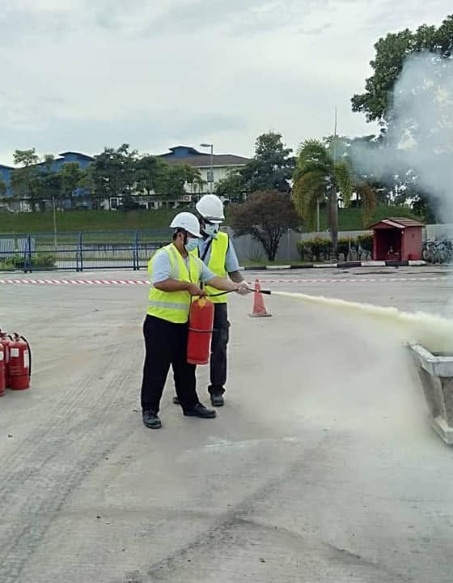
PROGRAMMES · 3 OF 3
NAJA SAFETY
CAPABILITY STATEMENT
JOHOR BAHRU · SEP 2026
Emergency and specialist programmes
PROGRAMME | DURATION | NOTES
Electrical safety | Custom | —
Emergency response & fire safety | 1 day | —
First aid & CPR | 2 days | —
Forklift & machinery safety | 1–3 days | Client provides the machine
Tailor-made HSE programmes | Custom | Built from the client's incident history
08
Durations shown are typical. Tailor-made programmes are scoped with the client before quotation.
17 PROGRAMMES
ON-SITE DELIVERY
TAILOR-MADE
08 / 14
Fire extinguisher drill, 2020.

Slide 9
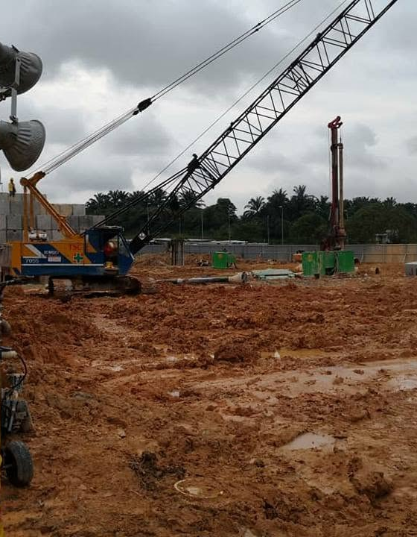
THE LAW · SECTION 29A
NAJA SAFETY
CAPABILITY STATEMENT
JOHOR BAHRU · SEP 2026
Section 29A: five employees is the threshold
5+
employees at a place of work — the employer must appoint one of its own employees, in writing, as OSH coordinator, and that employee must complete the required training
RM500,000
maximum fine under the amended general duty — ten times higher than before
09
In force 1 June 2024 under the OSH (Amendment) Act 2022 — the Act passed in 2022; the duty began in 2024. Employers already required to appoint a Safety and Health Officer under section 29 are excluded.
Section 52 allows directors, managers and similar officers to be charged personally unless they can show the offence occurred without their consent or connivance and that they exercised due diligence. A Safety and Health Committee is required where 40 or more persons are employed. The Factories and Machinery Act 1967 was repealed on the same date.
Naja Safety's OSH Coordinator programme prepares the appointed employee. [VERIFY: DOSH provider registration]
Sources: Lexology — OSH (Amendment) Act 2022 commencement · Herbert Smith Freehills Kramer, Compliance Check (May 2024) · Baker McKenzie InsightPlus — key changes to Malaysian OSH law.
IN FORCE 1 JUN 2024
5+ EMPLOYEES
40+ → SH COMMITTEE
09 / 14
Construction site during earthworks, 2018.

Slide 10
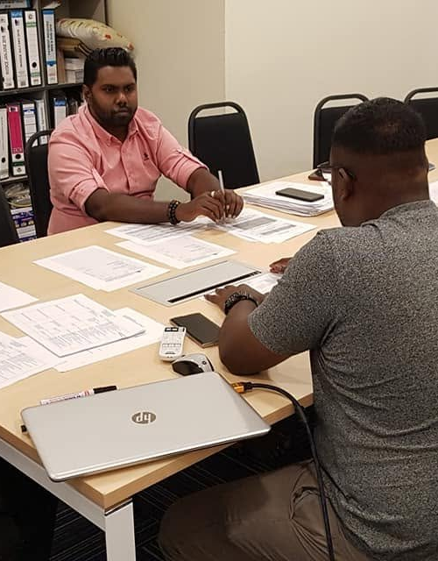
HRD CORP CLAIMS
NAJA SAFETY
CAPABILITY STATEMENT
JOHOR BAHRU · SEP 2026
Put the levy to work before it lapses
01 | Audit the employer's levy position
02 | Map programmes to the gaps
03 | Deliver the training
04 | Support the e-TRiS claim
10
THE FORFEITURE RULE · S.25 PSMB ACT 2001
Levy not used within a two-year window — from registration, from the date of the last financial assistance, or, where an employer has never claimed, from the levy-statement date on which the balance first reached RM10,000 — is forfeited above a retained RM10,000. Forfeited levy remains in the HRD Corp fund.
Programmes are structured for HRD Corp claimability, subject to the employer's levy balance and grant approval. [VERIFY: e-TRiS provider registration]
Source: HRD Corp Support Centre — "HRD levy forfeiture".
TWO-YEAR WINDOW
RM10,000 RETAINED
E-TRIS CLAIM SUPPORT
10 / 14
Course documentation review with a client, 2020.

Slide 11
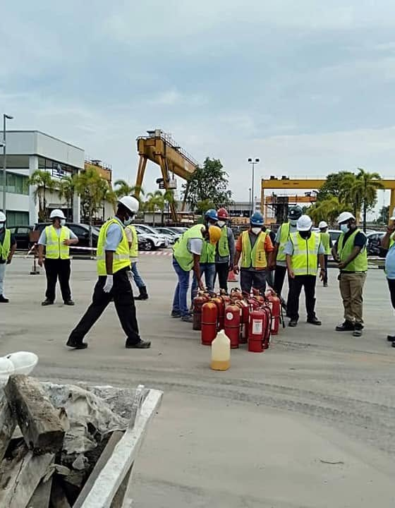
DELIVERY MODEL
NAJA SAFETY
CAPABILITY STATEMENT
JOHOR BAHRU · SEP 2026
Delivered on site, nationwide
ON-SITE
Training takes place at the client's premises. The client provides the room or work area, the workers, and machinery where the programme requires it; Naja Safety provides the trainer and the programme.
NETWORK REACH
Delivery nationwide through a freelance trainer network built over two decades, including Sabah and Sarawak.
11
LOGISTICS
Group size [INSERT] · Lead time [INSERT] · Languages of delivery [INSERT]
Statutory assessments requiring a registered competent person — Chemical Health Risk Assessment (CHRA), noise risk assessment, local exhaust ventilation inspection and ergonomics risk assessment — are coordinated through registered partner assessors on request.
ON-SITE AT CLIENT
NATIONWIDE
SABAH & SARAWAK
NO BRANCHES
11 / 14
Extinguisher briefing at a client premises, 2020.

Slide 12
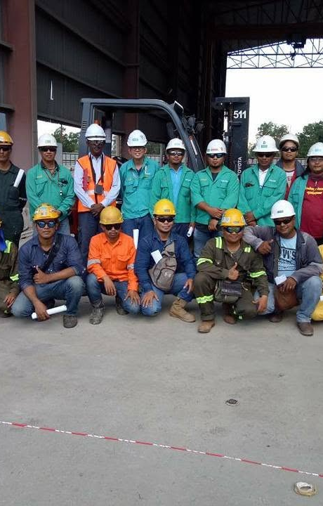
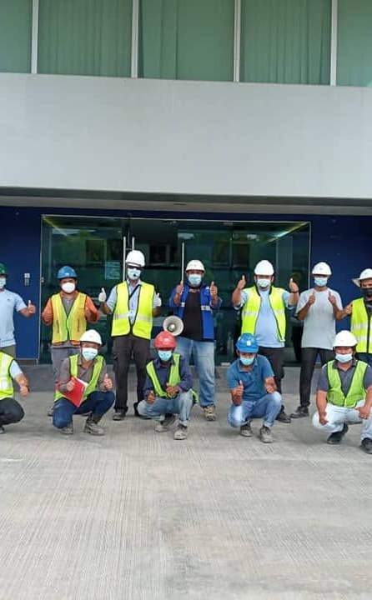
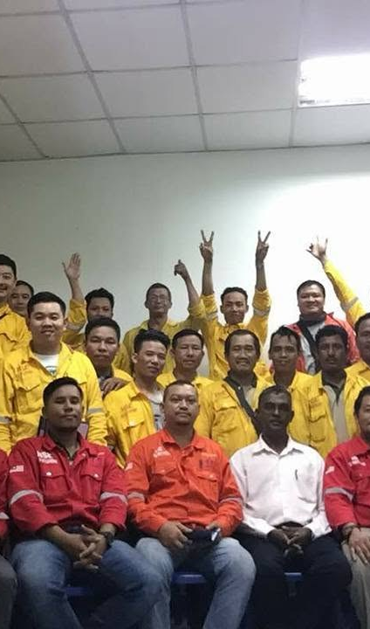
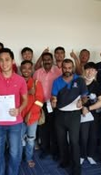
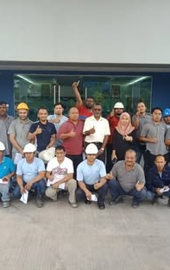
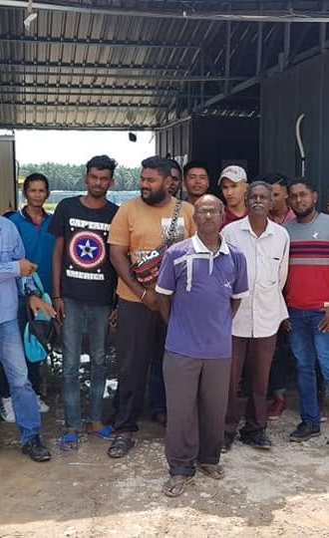
TRACK RECORD
NAJA SAFETY
CAPABILITY STATEMENT
JOHOR BAHRU · SEP 2026
Organisations served
Naja Safety's practitioners have delivered training and safety support to personnel at the following organisations.
[INSERT: CLIENT SCHEDULE]
Plain-text list, one organisation per line. Names are published only with each client's consent. No client logos are reproduced.
12
Client references available on request.
Right: training groups from Naja Safety sessions, 2018–2020.
TEXT ONLY — NO CLIENT LOGOS
REFERENCES ON REQUEST
12 / 14

Slide 13
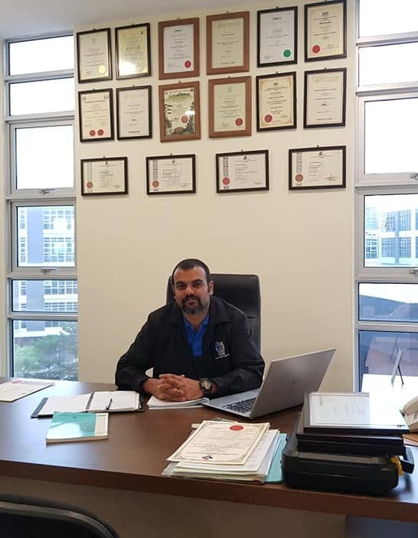
CONTACT
NAJA SAFETY
CAPABILITY STATEMENT
JOHOR BAHRU · SEP 2026
How to engage
CONTACT
James Issachar A/L Daniel — Director & Lead Trainer
016-730 1802 · najasafety@gmail.com [DECIDE: domain email]
TO PREPARE A QUOTATION
13
[INSERT: information required — programme, headcount, site location, dates]
TURNAROUND
[INSERT: typical quotation turnaround]
A formal quotation and training proposal is issued before any booking is confirmed.
016-730 1802
JOHOR BAHRU
QUOTATION BEFORE BOOKING
13 / 14
James Issachar at the Naja Safety office, 2018.

Slide 14

NAJA SAFETY
14
200603041203 (JM0449867-U)
09-03, Blok C, Kompleks Austin Perdana, Taman Mount Austin, 81100 Johor Bahru, Johor
016-730 1802 · najasafety@gmail.com
14 / 14

